Slide 1
Chinook Music Album Database
Online Music Store
My SQL

Slide 2
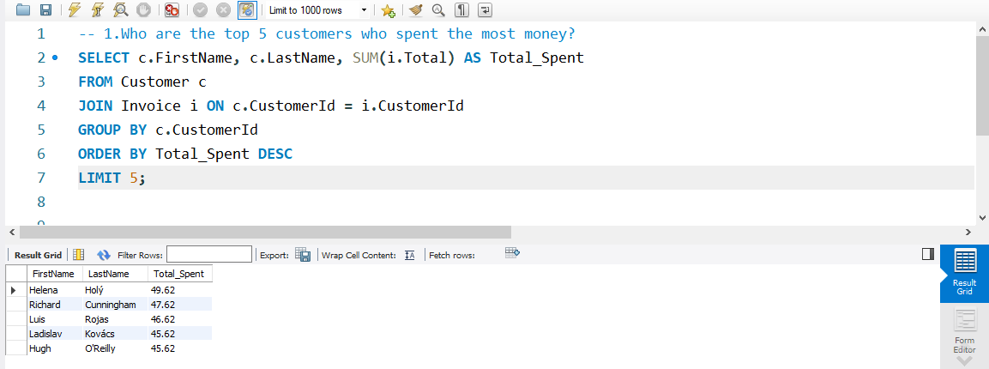
💰 Top 5 Customers by Total Spending
This query finds on top 5 CUSTOMERS spent the most money.

Slide 3
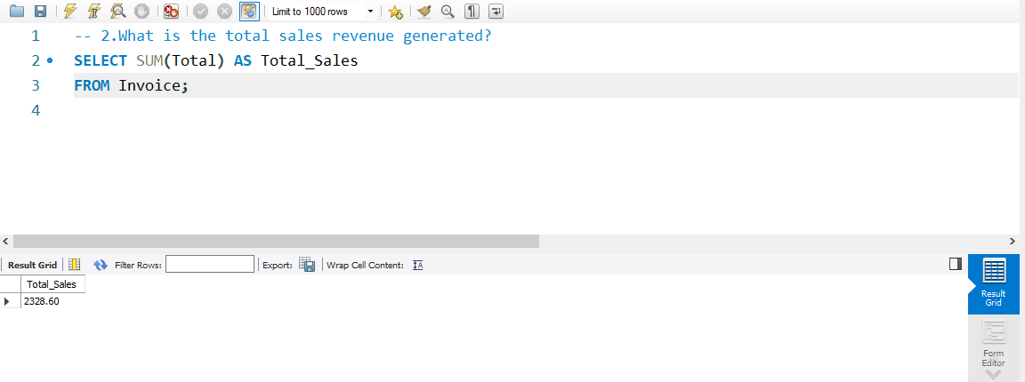
🧾 Total Sales Revenue from All Invoices
This query finds in TOTAL SALES revenue from invoices.

Slide 4
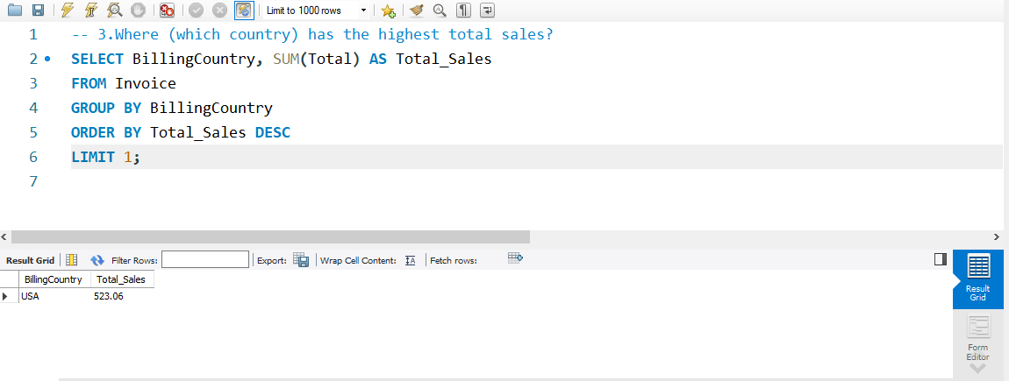
🏆 Top Country by Total Sales: USA ($523.06)
Query specify in based on TOP COUNTRY by total sales.

Slide 5
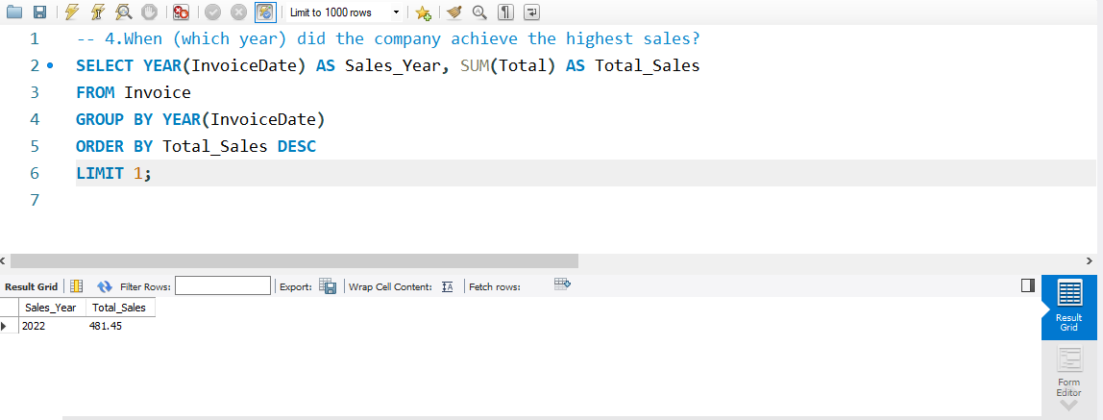
🏆 Year with Highest Sales Based on Invoice Data
This query identifies in YEAR with highest sales based on invoice data.

Slide 6
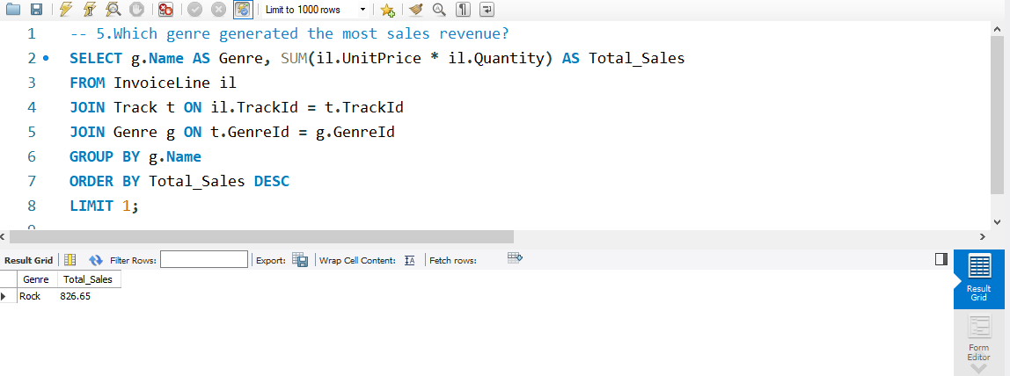
🎶 Top-Earning Music Genre by Sales Revenue
This query identifies in top earning music GENRE by sales revenue..

Slide 7
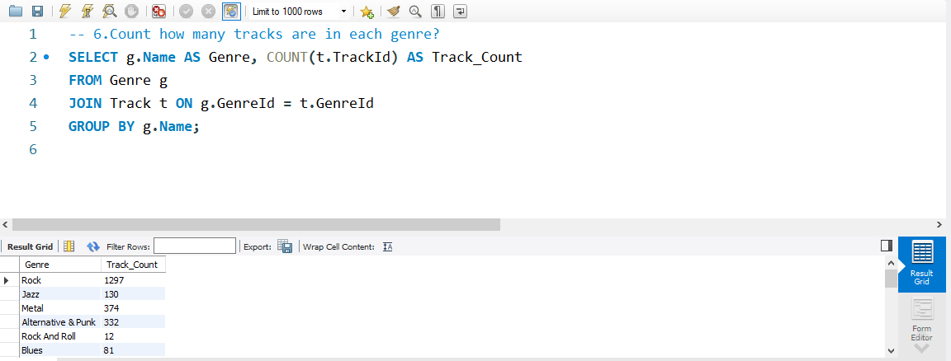
🎧 Track Distribution by Genre: Count of Songs in Each Category
Count for a track distribution by GENRE count of songs in each category.

Slide 8
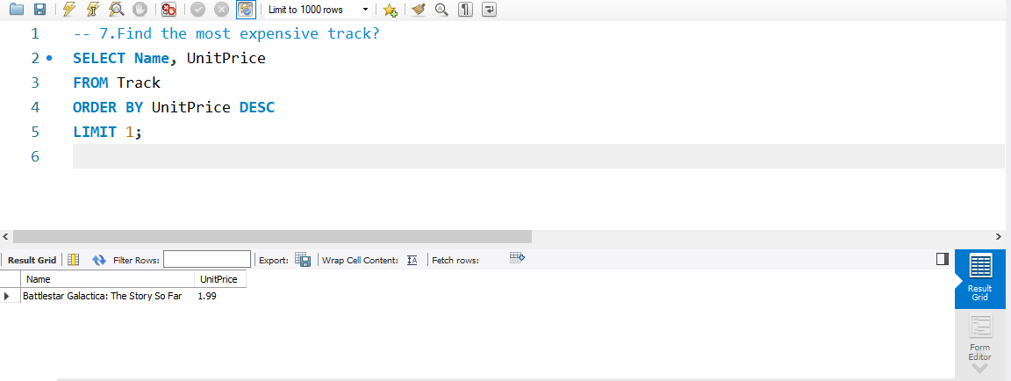
💰 Most Expensive Track in the Music Database
Find in most expensive TRACK in the music database.

Slide 9
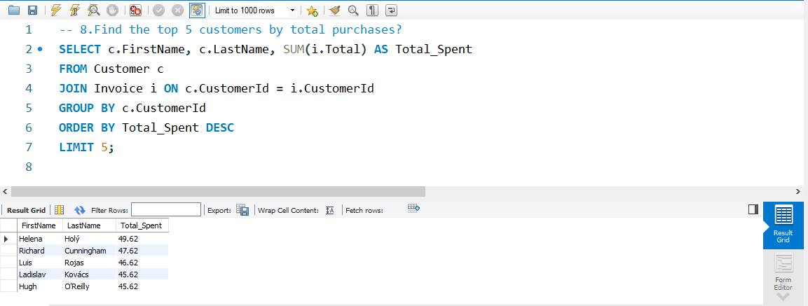
🏅 Top 5 Customers by Total Purchase Value
Find in TOP 5 CUSTOMERS by total purchase value..

Slide 10
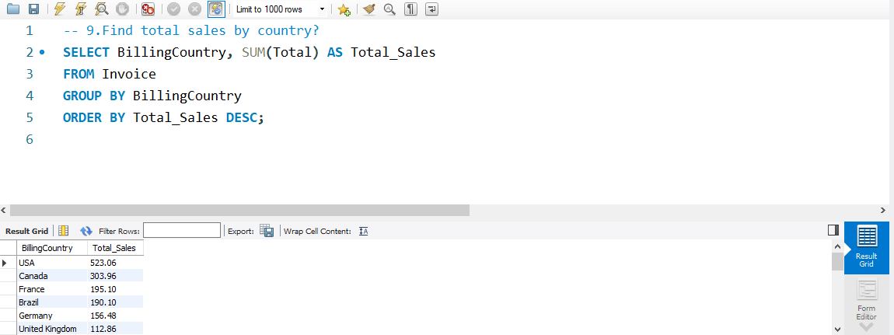
🌍 Total Sales by Country: Invoice-Based Revenue Breakdown
This query finds on total sales by country invoice-based revenue breakdown..

Slide 11
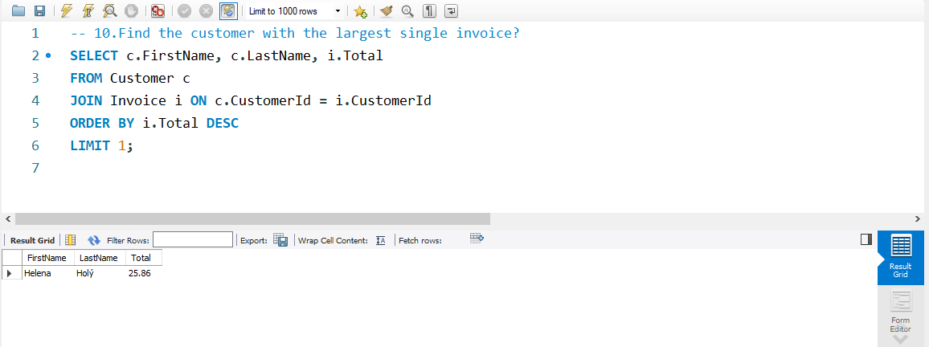
🧾 Customer with the Largest Single Invoice
This query finds on CUSTOMER with the largest single invoice.

Slide 12
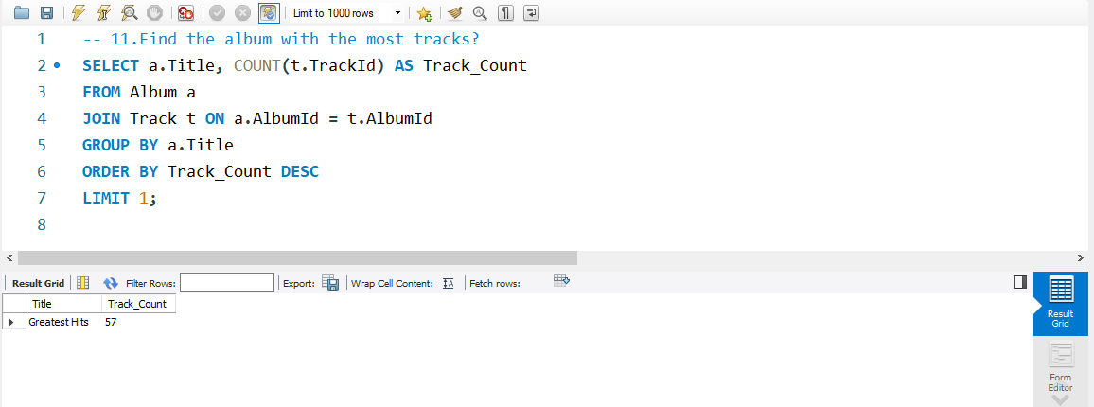
🎼 Album with the Highest Number of Tracks
This query finds on album with the highest number of tracks..

Slide 13

📀 Track Count per Album: Music Catalog Overview
Calculate track count per album music catalog overview..

Slide 14
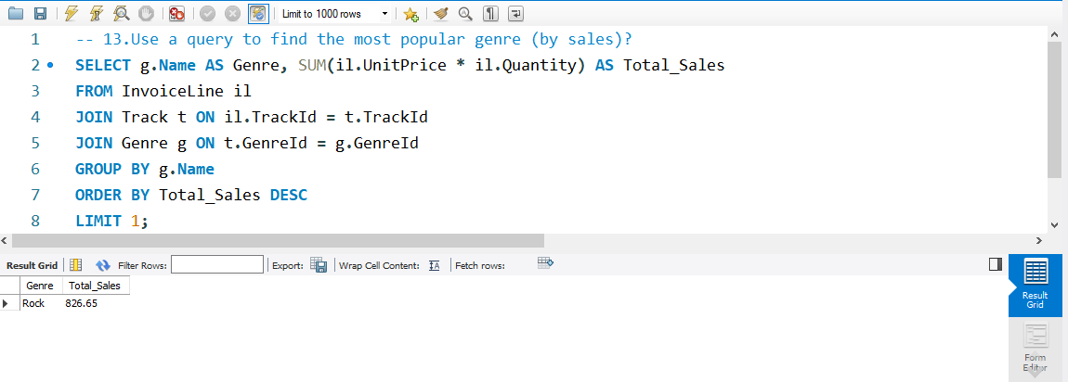
🎸 Most Popular Music Genre by Total Sales
Use most popular music GENRE by total sales.

Slide 15
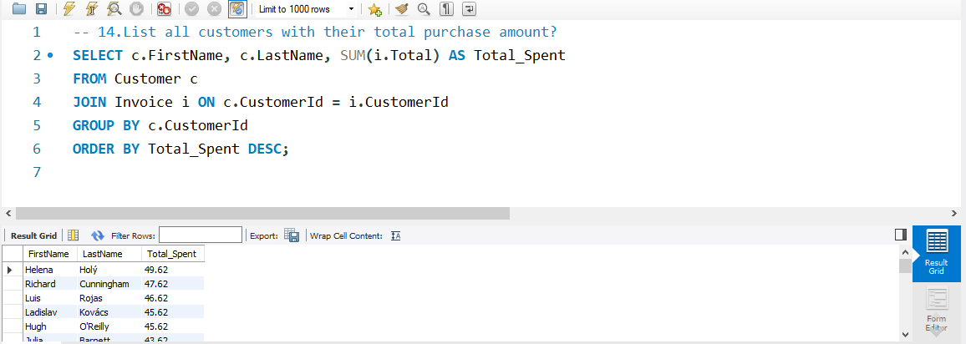
🧍‍♂️ Customer Spending Summary: Total Purchase Amounts
List CUSTOMERS spending summary total purchase amounts.

Slide 16
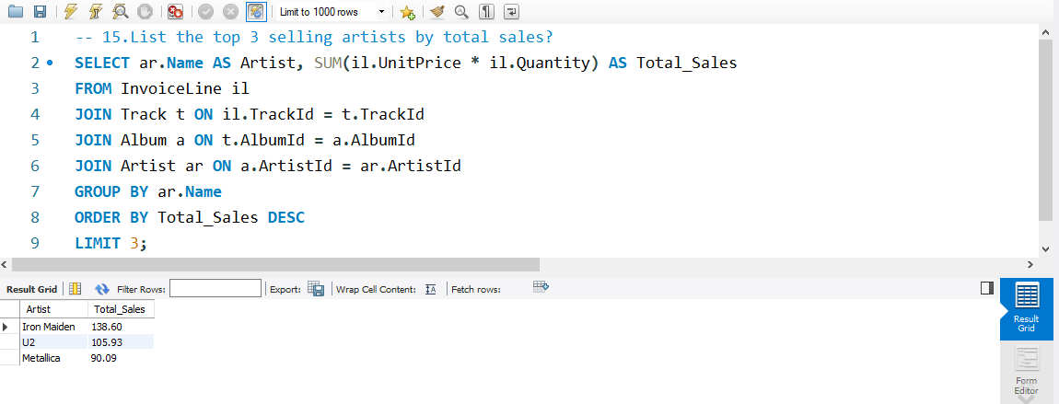
🎤 Top 3 Selling Artists by Total Revenue
List the TOP 3 selling artists by total revenue.

Slide 17
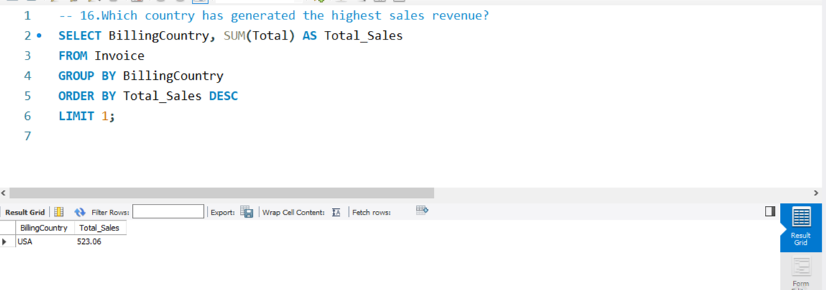
🌎 Country with Highest Sales Revenue from Invoices
This query finds on COUNTRY with highest sales revenue from invoices.

Slide 18
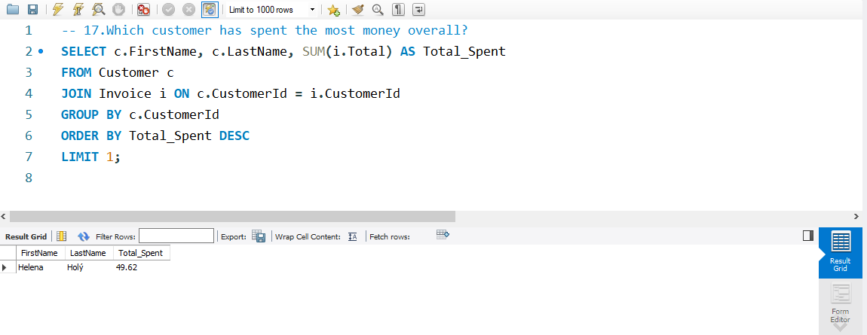
🏆 Top-Spending Customer Based on Invoice Totals
This query finds on top-spending CUSTOMER based on invoice totals .

Slide 19
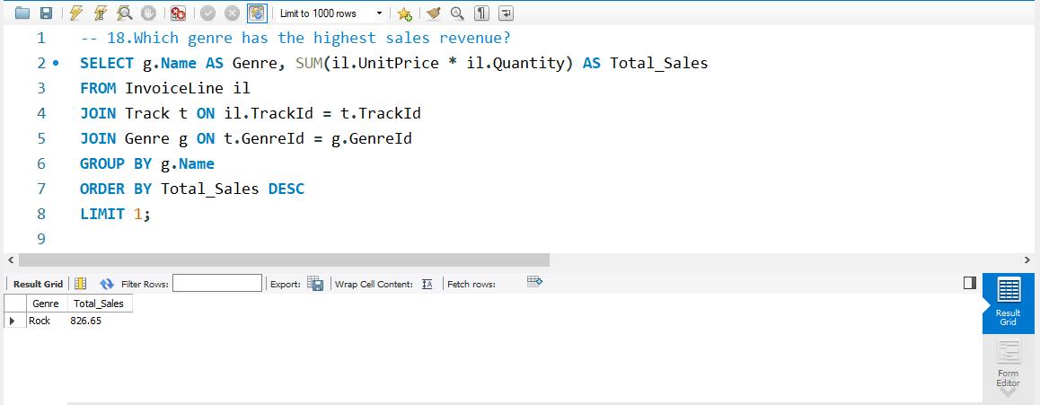
🎸 Highest Revenue-Generating Music Genre
This query finds on highest revenue-generating music GENRE..

Slide 20

🎤 Artist with Highest Total Sales Revenue
This query finds on ARTIST with highest total sales revenue.

Slide 21
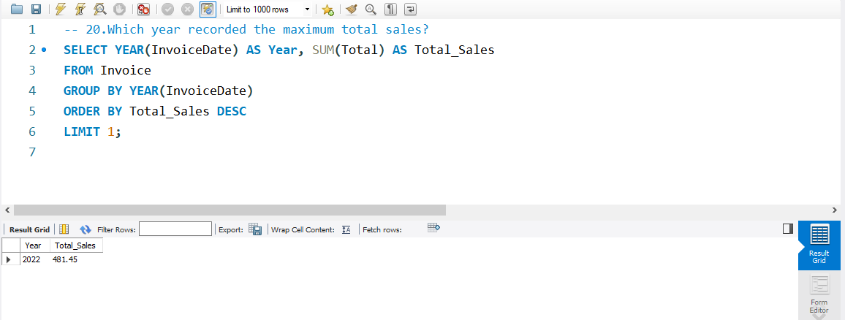
📈 Peak Sales Year Based on Invoice Totals
This query identifies the year with the highest total sales by summing the total column for each year in the Invoice table. It then sorts the results in descending order.

Slide 22
Thank You…

